Slide 1
Probability of the Data that Lies Outside the Upper Cutoff Point
0856706 Susan Ku

Slide 2
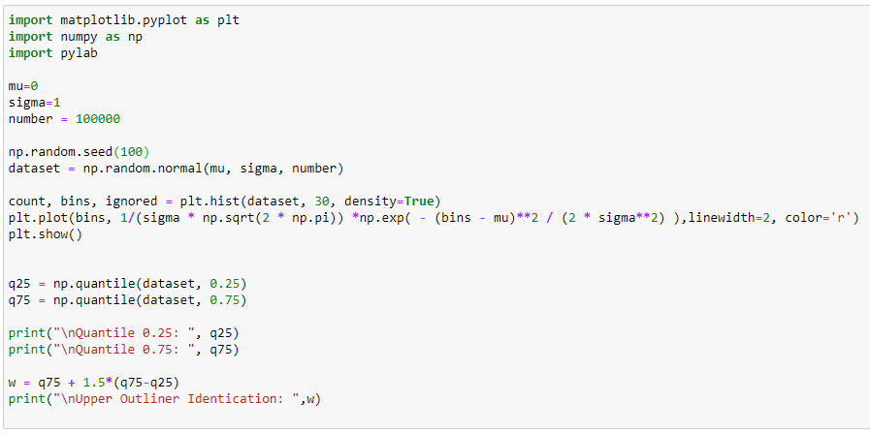
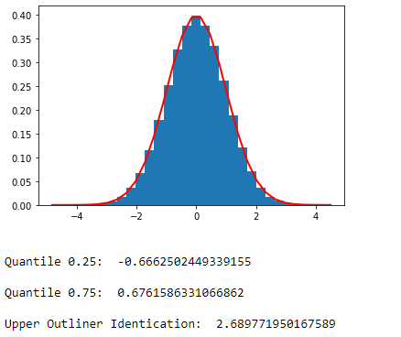
Calculate Upper Cutoff Point for Normal Distribution
Quantile_normal.ipynb

Slide 3
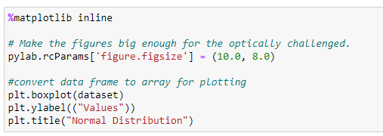
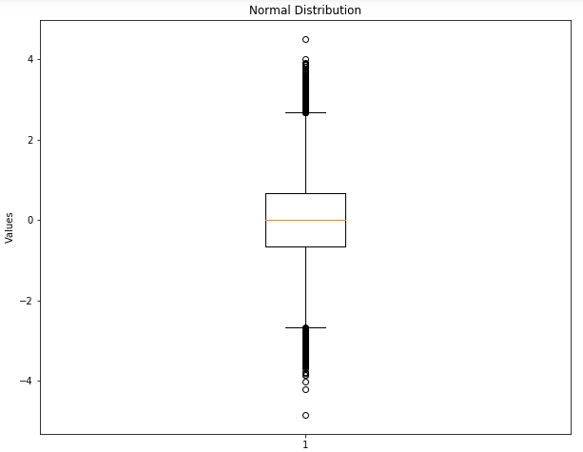
Boxplot
Quantile_normal.ipynb

Slide 4
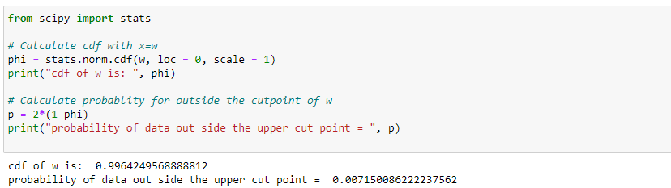
Calculate Probability of the Data that will Lie Outside the Upper Cutoff Point
Quantile_normal.ipynb

